Slide 1
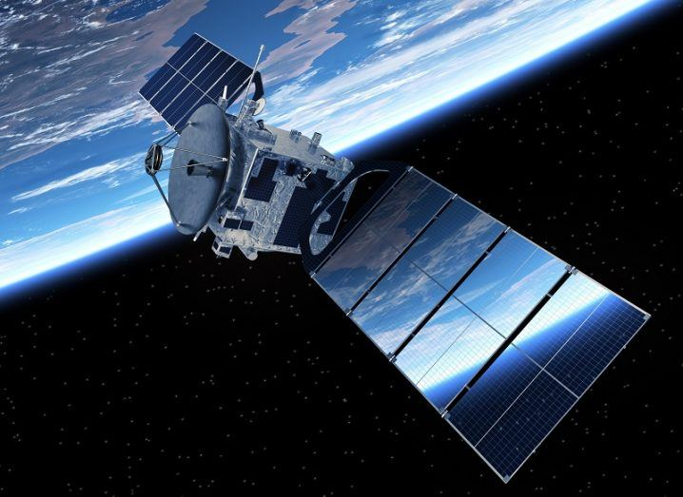
Satellites Data Analysis
By:-GAURAV KUMAR

Slide 2
Introduction
Dataset
active satellites currently in orbit around the Earth
basic information about the satellites and their orbits
Mathematica
build-in data like “SatelliteData”
strong functions for analysis
Aim
extract the meaningful information.
summarize and visualize them

Slide 3
Dataset Variables
26
variables
Current Official Name of Satellite
Country of Operator/Owner
Class of Orbit
Perigee (km)…
Launch Site

Slide 4
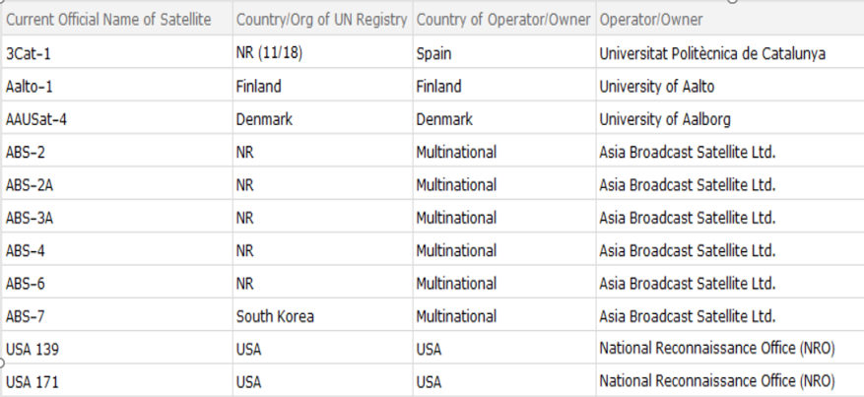
Load the Dataset
Dataset is loaded and dimensions of the dataset are checked.

Slide 5
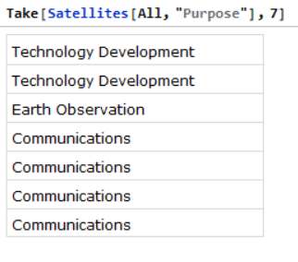
Data Manipulation and Analysis
Select Satellites used for different purposes

Slide 6
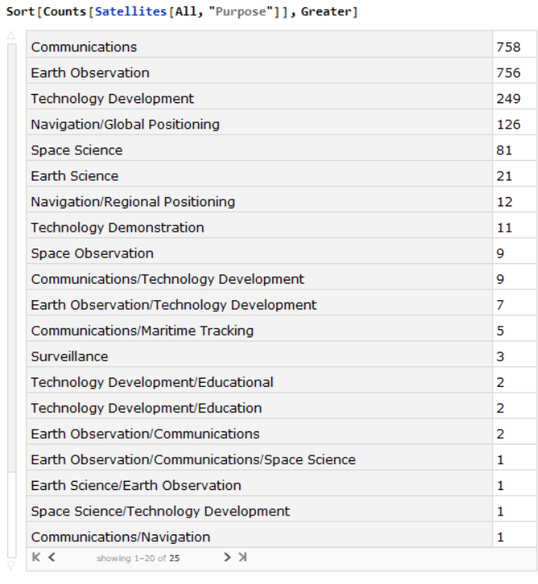
Data Manipulation and Analysis
Counts and sort function—Show purpose of satellites

Slide 7
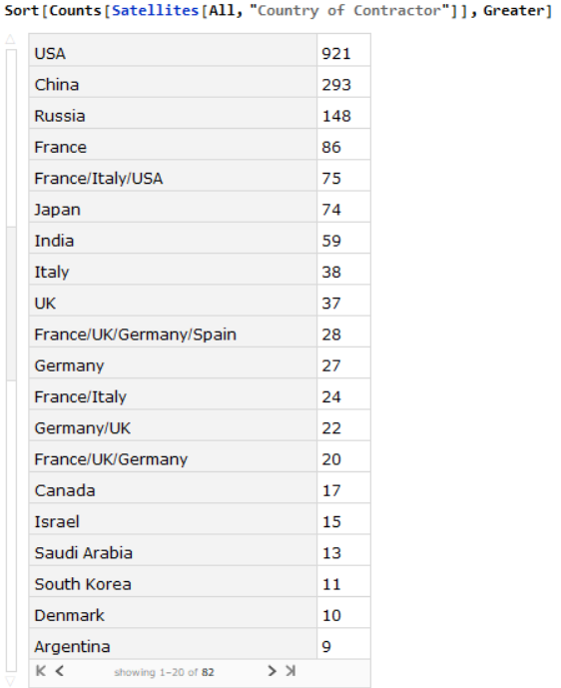
Data Manipulation and Analysis
USA is the contractor for maximum number of satellites

Slide 8
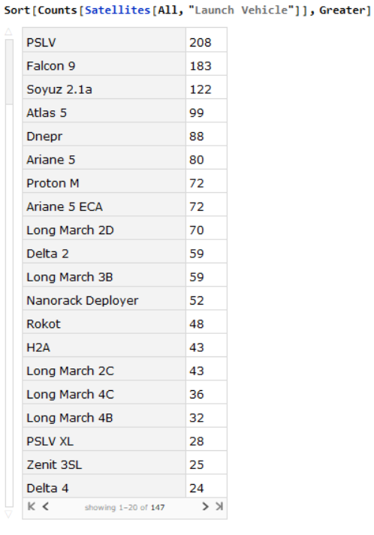
Data Manipulation and Analysis
Most used Launch vehicle is PSLV

Slide 9
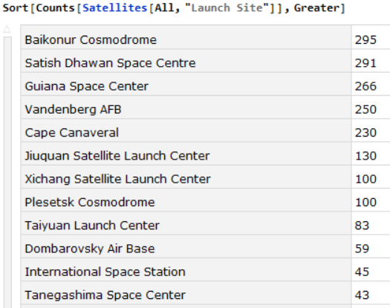
Data Manipulation and Analysis
Maximum number of vehicle launch has happened from the Launch Site : Baikonur Cosmodrome .

Slide 10
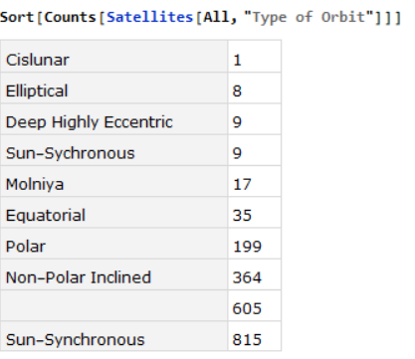
Data Manipulation and Analysis
Maximum number of Satellites in the orbit : Sun-Synchronous

Slide 11
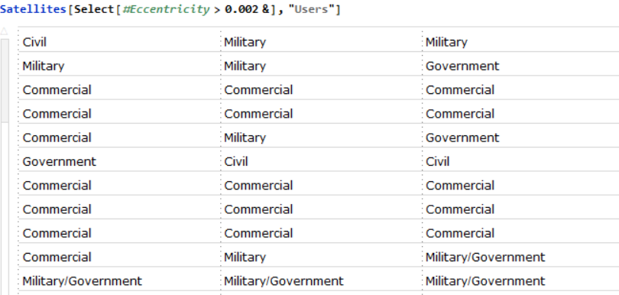
Data Manipulation and Analysis
Satellites whose eccentricity value is greater than some value .

Slide 12

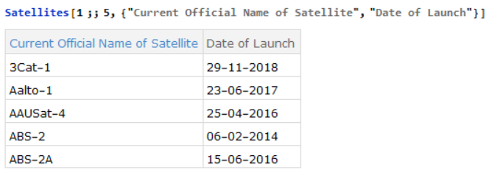
Data Manipulation and Analysis
Satellite name which is having the maximum Apogee value
Extract the date of launch of the satellites.

Slide 13
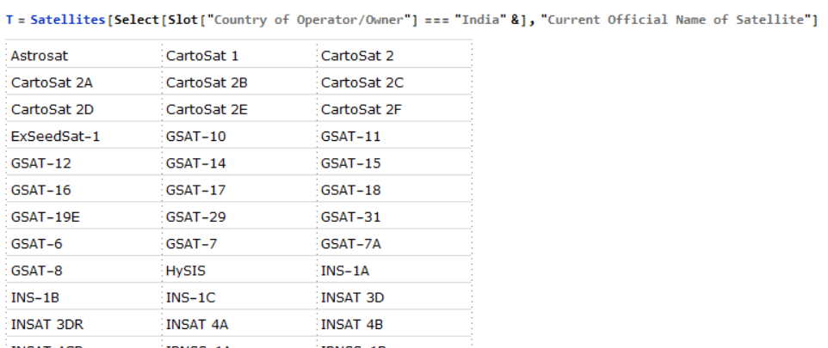
Data Manipulation and Analysis
All the names of satellites whose owner is India

Slide 14
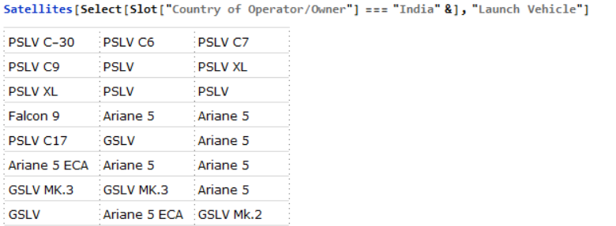
Data Manipulation and Analysis
All launch vehicles have been used by India can be extracted

Slide 15
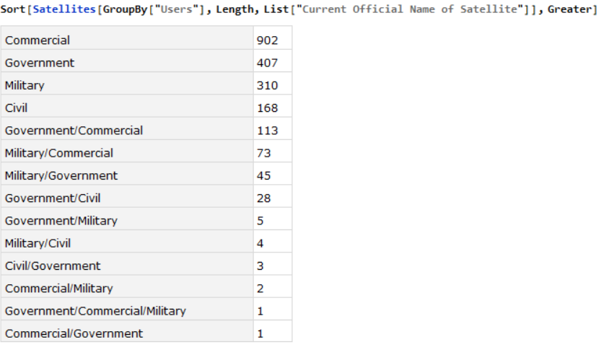
Data Manipulation and Analysis
Groupby and sort function --filter the data and understand easily

Slide 16
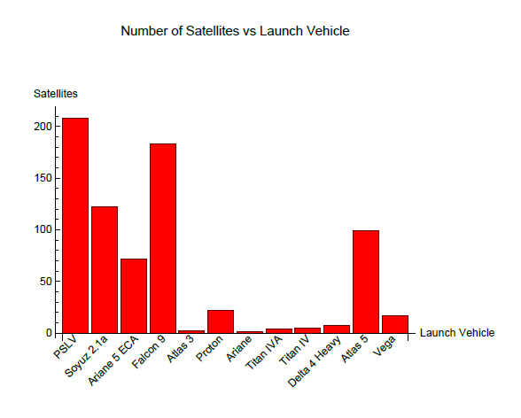
Data visualisation
Interpretation: From the Bar-chart we can see that the PSLV vehicle has been used the most for Satellite launches.

Slide 17
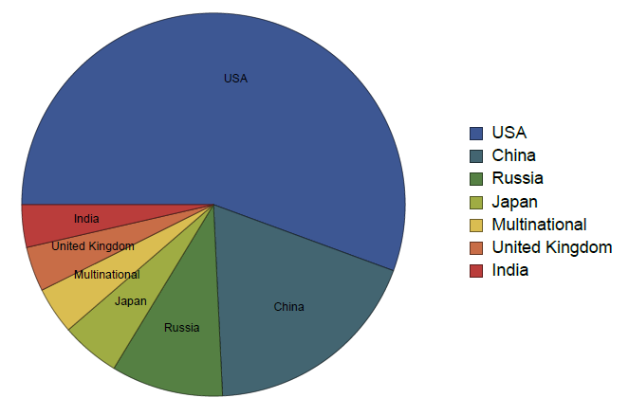
Data visualisation
Interpretation: The pie chart shows that the USA has the maximum number of Satellites in orbit around Earth.

Slide 18
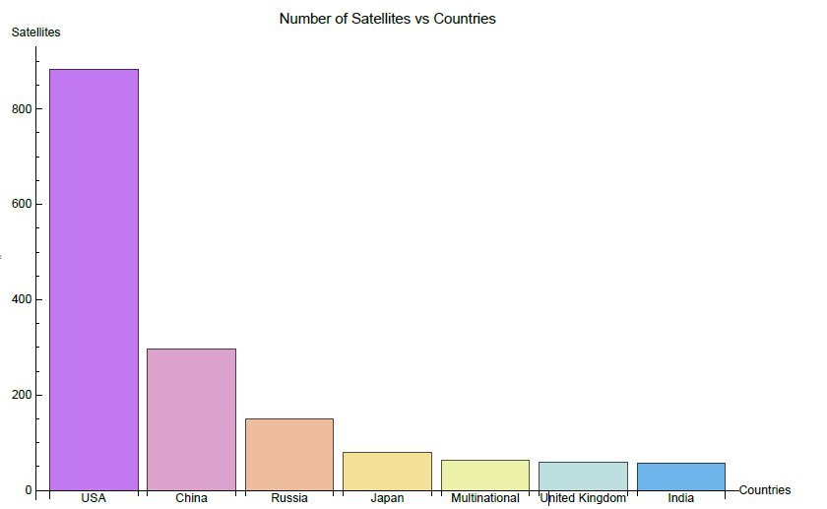
Data visualisation
Interpretation: USA having the maximum number of satellites around earth

Slide 19
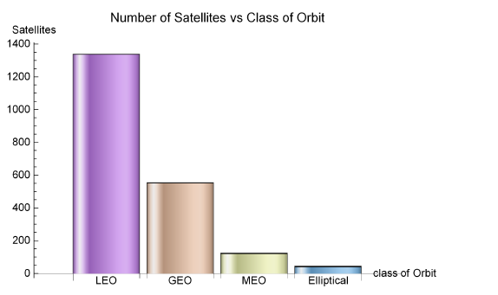
Data visualisation
Interpretation: USA having the maximum number of satellites around earth.

Slide 20
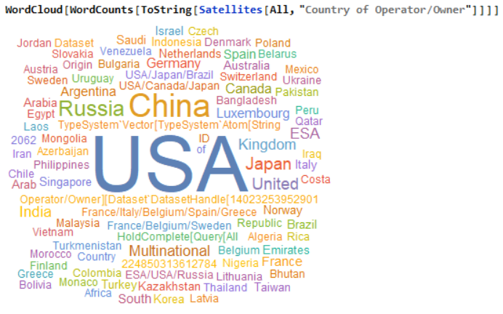
Data visualisation
Interpretation: USA having the maximum number of satellites around earth.

Slide 21
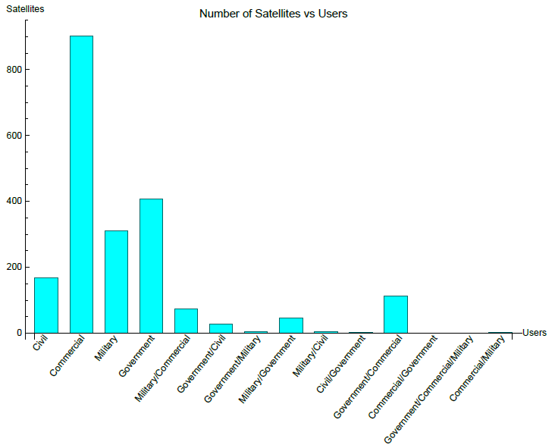
Data visualisation
Interpretation: Maximum number of satellites around earth are under Commercial users.

Slide 22
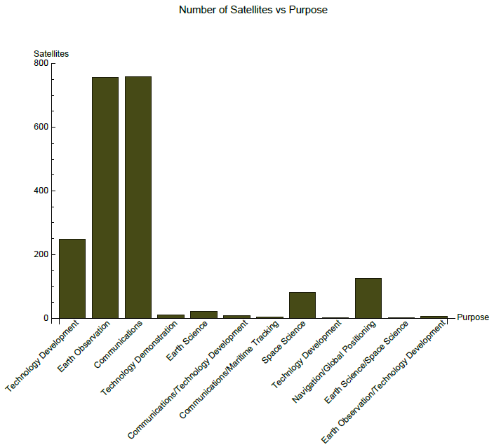
Data visualisation
Interpretation: Maximum number of satellites in orbit are used for Communications purpose.

Slide 23
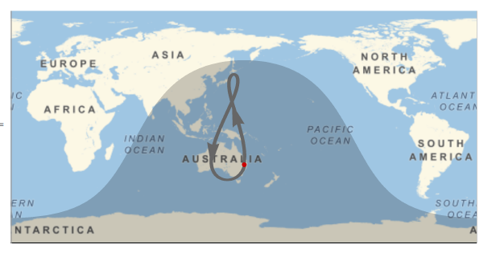
Additional demonstration on Satellites using Mathematica Functions:

Slide 24
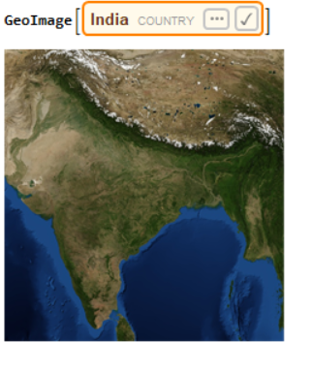
Check the satellite view of the country.

Slide 25
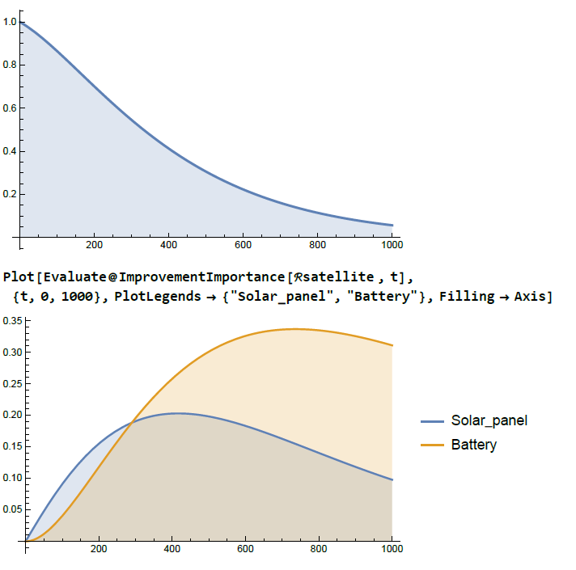
Mathematica’s in built function to make plot

Slide 26
Conclusion
Mathematica
build-in data
show results intuitively
Further Analysis
extract more information about power estimation , position of satellites etc.
analyze data clearly
various functions

